Slide 1
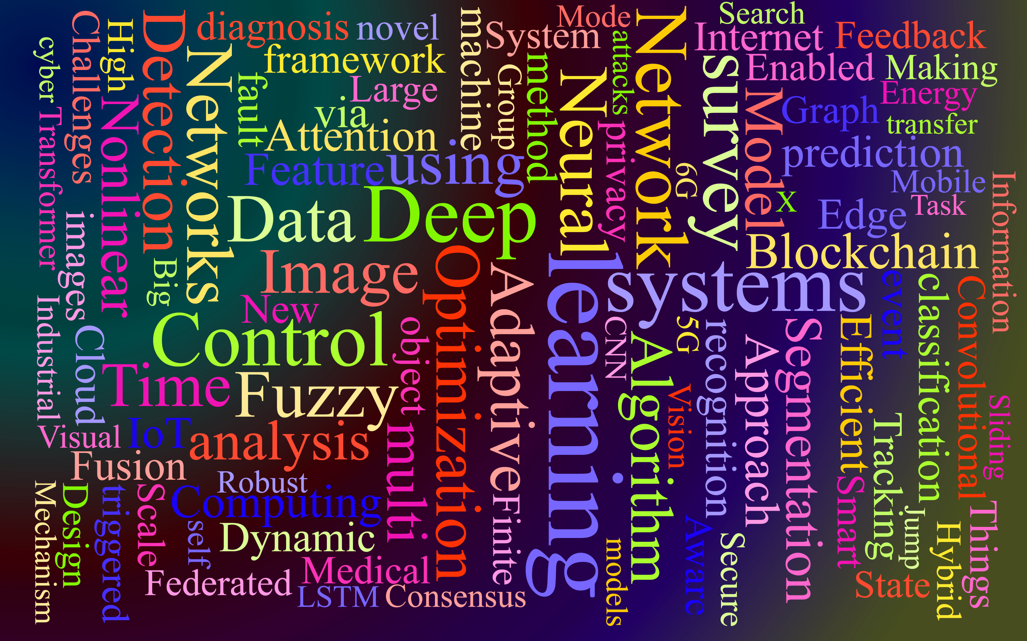
Computer Science Review The Story So Far…
Week ???
Brian Packer

Slide 2
Comp. Sci. Fun. & Networked World
Computers are finite-state machines which convert analogue electrical signal samples into on-off digital signals.
This means they must eventually resolve every input processed with a definite outcome of either 0 or 1, which we can control with loops, logic, and nested programming.
Hardware like memory and processors impose physical limits on speed, capacity, and latency on the programming we can process computationally.

Slide 3
Discrete Maths; Algorithms and Data Structures
Variables and logic can be used to represent any things which can be defined, so we can make true or false evaluations of things with specified and finite values.
We can model anything as groups of variables (data) and the conditional or augmentative relationships between those variables (functions).
Maths is a common language that can be transferred to any situation with any technology with enough critical design and consideration.
Most people don’t think in numerical models, so, we code.

Slide 4
Math Modelling and Numerical Analysis
Some variables are deterministic (same input & process will always yield the same output) and some are probabilistic (a factor of probability will vary the output).
Statistics can be used to analyse data, derive relationships between variables, estimate the amount and range of randomness between them, and guide algorithm design.
We can use these levels of variability to get around the limitations of computing and emulate/model the more chaotic real-world in code.

Slide 5
Python & Java
We can turn logical or mathematical expressions into code and use that to model and analyse the world around us as a large, interrelated network of processes and models.
We can turn algorithms into programming functions, data structures into programming objects, and numerical models into conceptual groups called classes.
We can evaluate the performance, complexity, accuracy, suitability, flexibility, and efficiency of our code against the theoretical maths from which our classes are derived.

Slide 6
Business IT Systems & Project Management
People and organisations have specific needs which can also be modelled as data, relationships, processes, and outputs.
User/client feedback can be statistically analysed as data and expressed as new processes or requirements.
Development tasks, their durations, costs, and complexities can be analysed and calculated like any other model and we can optimise organisational efficiencies just like algorithms.
There’s a level of chaos in this process, which requires large flexibility and change-tolerance in our processes and code.

Slide 7
Databases and Web Systems
Databases are stores of machine readable data which can push and pull data to and from many users or systems from a central store of files and connections, usually a non-Local remotely accessible server.
The data can be structured or unstructured, but structuring the data (as objects) can give it deeper/clearer meanings and allows us to set rules (code) by which it can then be processed.
Web browsers request and read data values within HTML, CSS and other standardised data files from a web server at an IP address. By “reading in” the data between tags, it can handle the data accordingly.

Slide 8
Which leads us to…

Slide 9

Design and Analysis of Algorithms Emphasis on “Design”
Week 1
Brian Packer

Slide 10
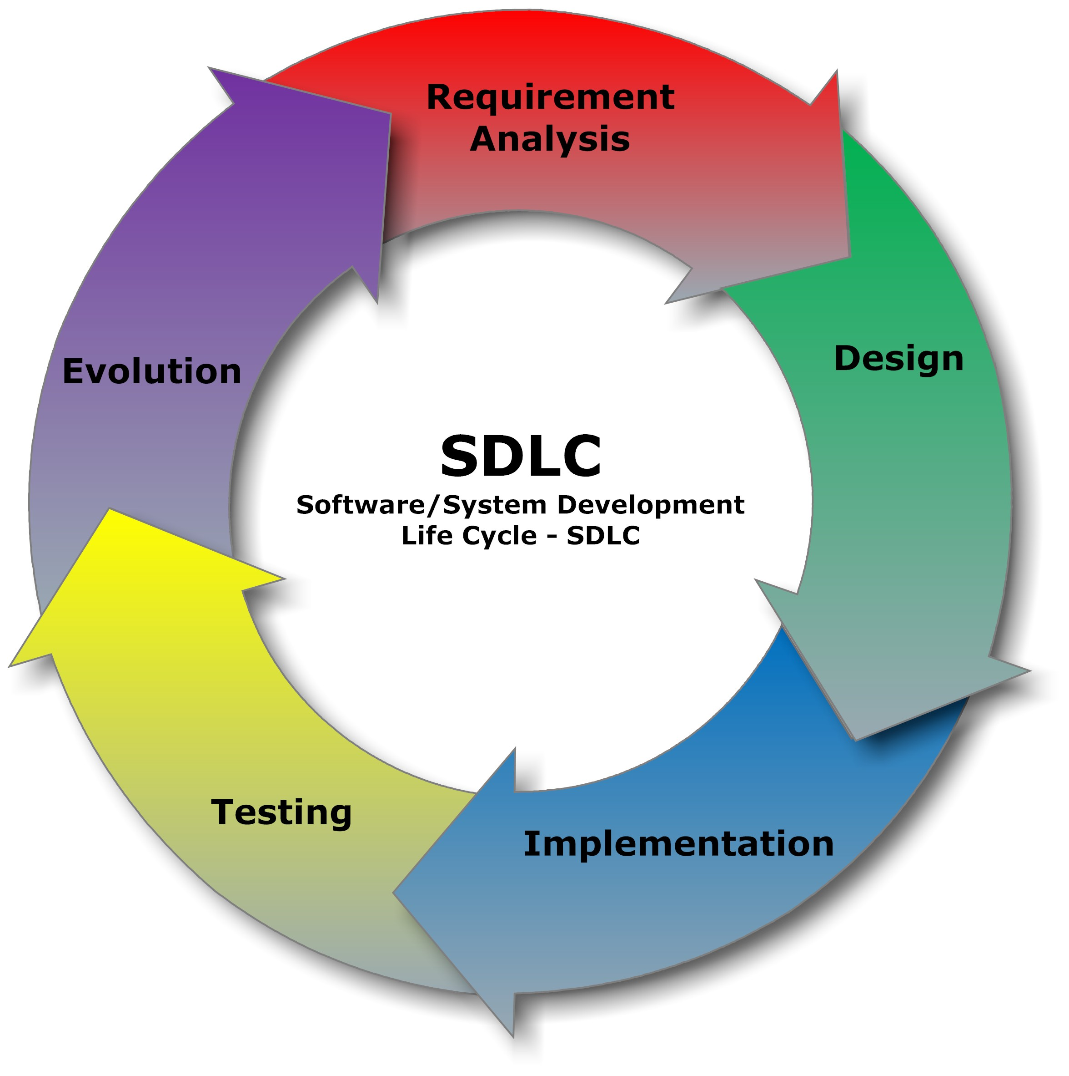
Software Engineering
Requirement Analysis
Design
Implementation
Testing
Evaluation/Evolution

Slide 11
Software Engineering
Requirement Analysis
Design
Implementation
Testing
Evaluation/Evolution
All Engineering
Requirement Analysis
Design
Implementation
Testing
Evaluation/Evolution

Slide 12
All Engineering
Analysis
Design
Implementation
Testing
Evaluation
All Design
Requirement
Solution
Prototype
Experiment
Reflect

